Slide 1
Distributed work
Aurimas Danaitis
VP Engineering @ Adform
Notes:
Public speaking story

Slide 2

Agenda
Team concept
Agile team
Project vs Product
Distributed vs Remote
Collaboration tools
Takeaways
Notes:
Question – who works in distributed teams?
I proudly borrowed the pictures from internet in this presentation, so no credits to me

Slide 3
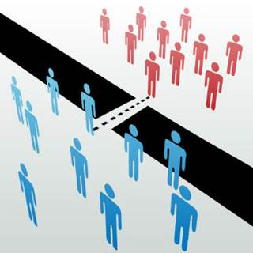
Team concept
“Us” and “them”
“Us” is a team
Differences between us and them
Synergies
Trust / safe environment
Clear common goal
Notes:
Story of Kaunas and Qatar – different differences.
Trust -> Open conflict ->Commitment ->Accountability->Restult orientation / goal
It takes time for agile team to become efficient

Slide 4
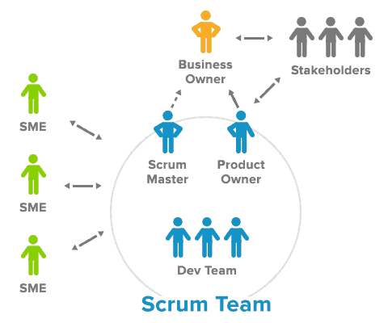
Agile team
Product Owner
Scrum Master
QA
Software Engineers
Notes:
How much collaboration do you need?
I brougth this up in order to make it more clear how distribution can work (or encounter more challenges)

Slide 5
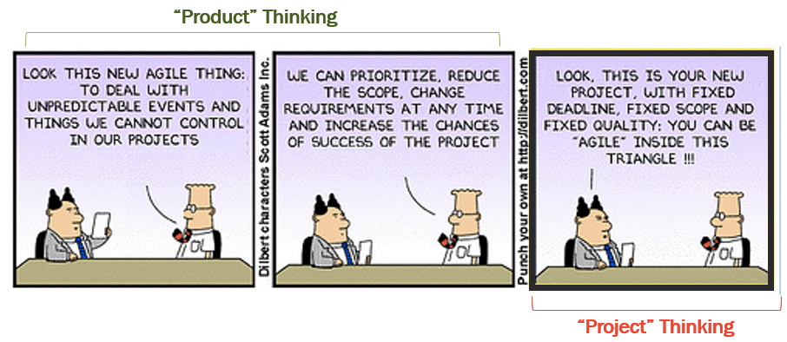
Project vs Product
Project
Client – in different location
Project manager, BA, Tech Lead on client side often is a benefit
Usually number of interdependent teams is not big
Product
PO can be close to stakeholders
Number of interdependent teams can be big
Notes:
Story of Qatar, when PM and tech lead was on-site
Adform – highly interdependent product and over 400 specialists working and need to collaborate

Slide 6
Distributed vs Remote
32 team total in 5 locations
22 remote
6 remote with PO/SM in other location
4 distributed (engineering split)
When to have a distributed Team
Can not find competence
Need for different time zones
Temporary ☺ (need to survive)
Notes:
You need to communicate between teams and withing team.
And guess what – cultural, environment difference, habits are the there locally or in a distance, so overcomming these differences can be even a bigger challenge.

Slide 7
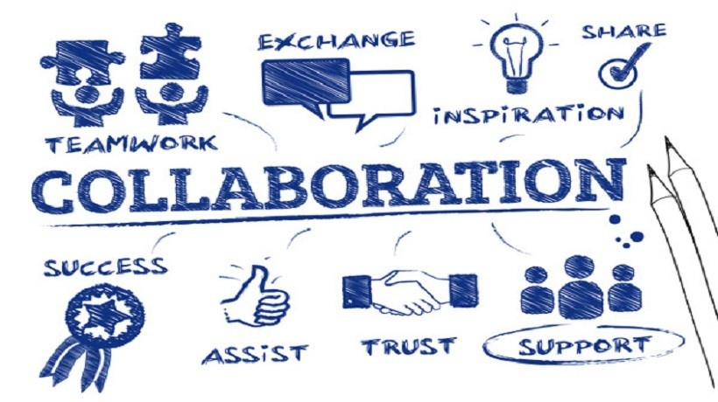
Collaboration tools
Atlassian stack (Jira, Confluence)
Microsoft Office 365 (OneDrive, Teams, Excel etc.)
Slack
Git etc.
Skype for Business, Lotus Notes
Mobile phone calls
Notes:
Development tools – by default.
For big scale meetings - GotoMeeting

Slide 8

Big brother …
Not for everyone
Notes:
Maybe OK for some freelancers
Hope Vaidas or Donatas won’t come to stage and tell the opposite, if this happens we will have interesting discussions afterwards☺

Slide 9
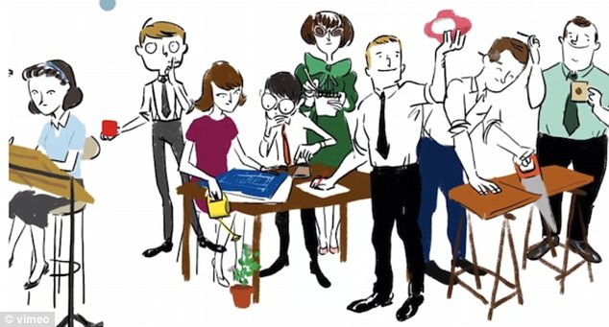
Recommendations
Keep in mind time zones / work week
Work with rules and processes
Agree on rules
Give trust
Provide feedback
Listen to all “distributed” parties
Change fast
Use right tools
Notes:
Split responsibilities / roles – clearly.
Change fast – environment, rules, people

Slide 10
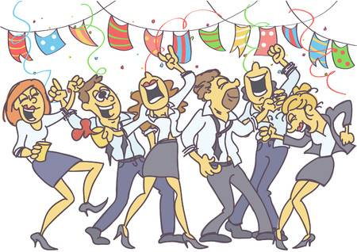
Takeaways
Accept the need/fact
Meet at least once face 2 face
Use right tools
Make changes if Team does not perform
Meet live when possible
Notes:
Creating trust is paying off, being apart it makes slower.
I am old-school
With tools you embed and automate process and agreed rules
I personally try to buy as much as possible live time – both meeting individually and in a whole team

Slide 11

Let’s connect
https://www.linkedin.com/in/aurimasdanaitis
Notes:
Vaidas went to the same school, his class being just next door
Donatas and me spent almost 9 years working together

